Slide 1

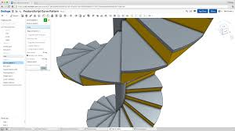

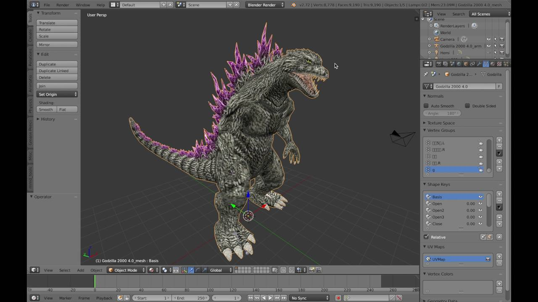
Westerdals
Introduction to 3D modellering
jakob.a.nilsson@gmail.com
Notes:
Om mig: Har modellerat i 3d i 20 år och 17 år parametriskt
Olika ting from dataspillbanor på sent 1900tal till subsea pipeline connectors och møbler.
Kør presentation på eng då det ær liten poæng med terminologi på svensk.

Slide 2
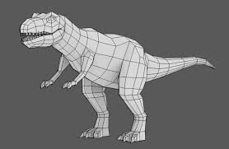
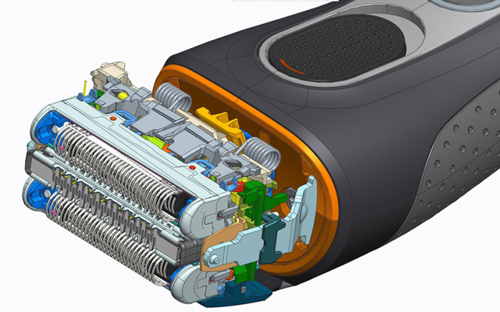
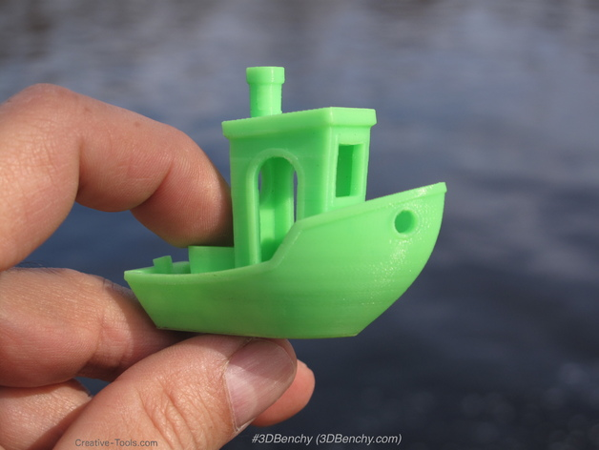
What is 3D modelling?
Practice:
CGI
Design
Engineering
DIY 3D printing...

Slide 3
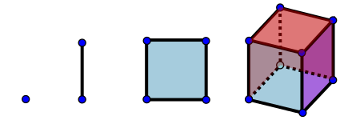
What is 3D modelling?
Theory:
0 Dimensions = No distance = A point
1 Dimension = Length = A line
2 Dimensions = Length and width = A square
3 Dimensions = Width, length and thickness = A cube
Notes:
Solid modelers and surface (mesh modelers)

Slide 4
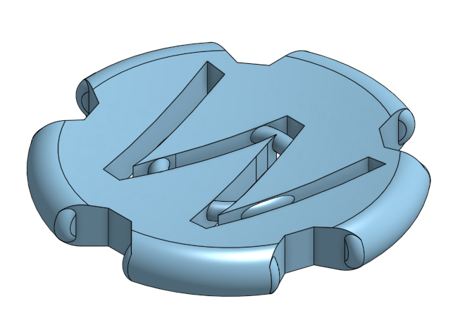
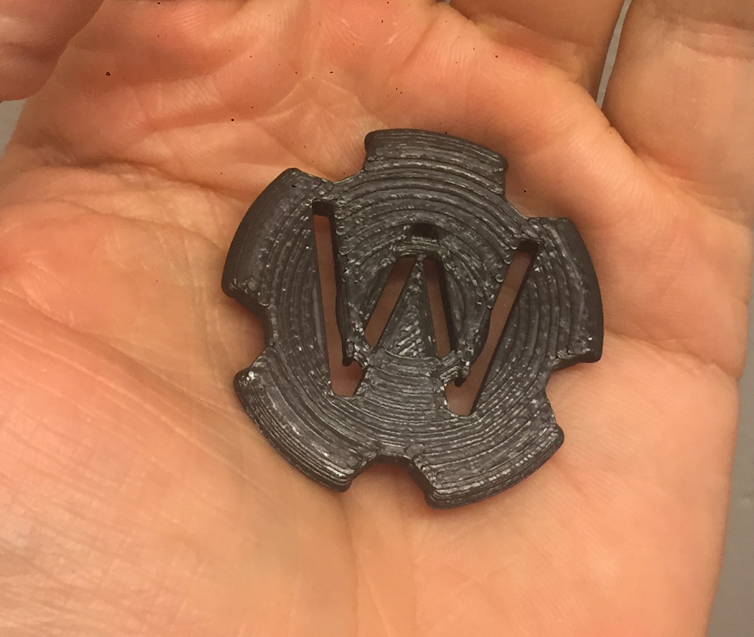
Task: Design a makercoin and print it
Try at least one modelling program
Design at least one makercoin (Diameter ca 40 mm, max height 15 mm)
Add some interesting features of your choice, using patterns, flat and round details.
Notes:
Passsa på att testa nu och vælj sen vilket ni kør med

Slide 5
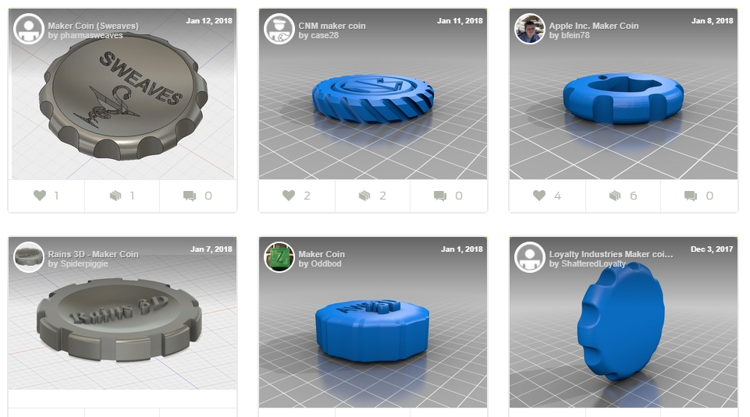
Makercoins!
https://www.thingiverse.com/tag:Maker_Coin/page:1
https://www.thingiverse.com/tag:MakerCoin/page:1

Slide 6
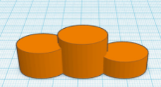
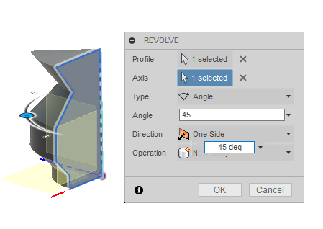
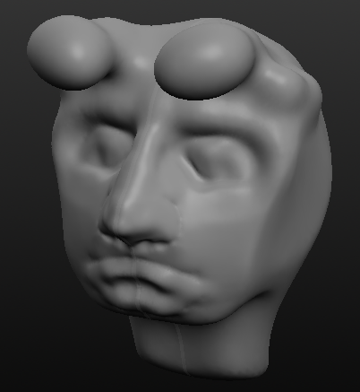
Different tools for different tasks
Tinkercad Primitives modeling
Onshape Parametric CAD light
Fusion360 Parametric CAD full
Others:
Sculptris Digital clay sculpting
Sketchup Buggy and too basic
Blender Full CGI suite

Slide 7

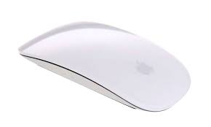
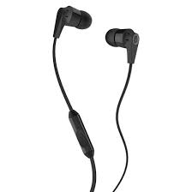
Recommended equipment
Pen and paper
Mouse
Headphones

Slide 8
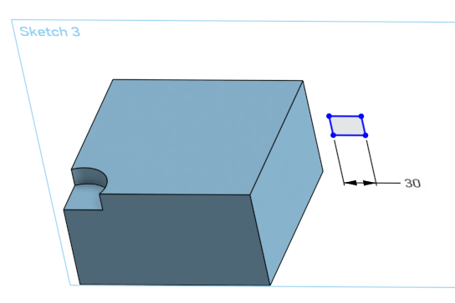
CAD Terminology
Workplane, origo
Sketch, line, dimension
Relation or constraint
Profile
Feature
Body, face, edge,vertex
Orthographic view and perspective view

Slide 9
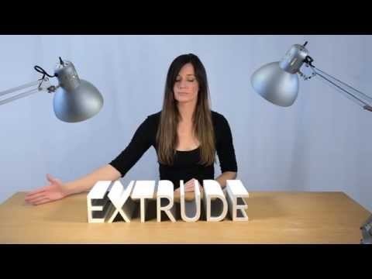
Modelling concepts
https://www.youtube.com/watch?v=ouvf-4wciak

Slide 10
Resources
Tinkercad
Get and try https://www.tinkercad.com
Good built in beginner guides, do them! https://www.tinkercad.com/learn/projects#/learn/project-gallery;collectionId=O2C1PXBIQ2KHCOD
How to make a maker coin https://www.youtube.com/watch?v=zifrdN4Yuds
How to make patterns https://www.youtube.com/watch?v=HBIJYIUM3r4
How to make a cup https://www.youtube.com/watch?v=HeTqjwfGJgU
Want to do more advanced shapes? https://www.youtube.com/watch?v=HyYeR76vEzE
Onshape
Get and try https://www.onshape.com/
How to make a maker coin https://www.youtube.com/watch?v=wSBLOhIFz6s
Fusion360
Get and try fusion360.autodesk.com
How to make a maker coin https://www.youtube.com/watch?v=Kv1xYpV_yS4&t=11s
How to make a maker coin https://www.youtube.com/watch?v=tGtNLpYSXOU
Scuptris Not needed for makercoin-week!
Get and try pixologic.com/sculptris/
Learn how to sculpt https://www.youtube.com/watch?v=OqoA9hFyNI4

Slide 11
Task: Design a makercoin and print it
Try at least one of Tinkercad, Onshape or Fusion360.
Design at least one makercoin (Diameter ca 40 mm, max height 15 mm)
Add some interesting features of your choice, using patterns, flat and round details.
Notes:
Passsa på att testa nu och vælj sen vilket ni kør med

